Slide 1
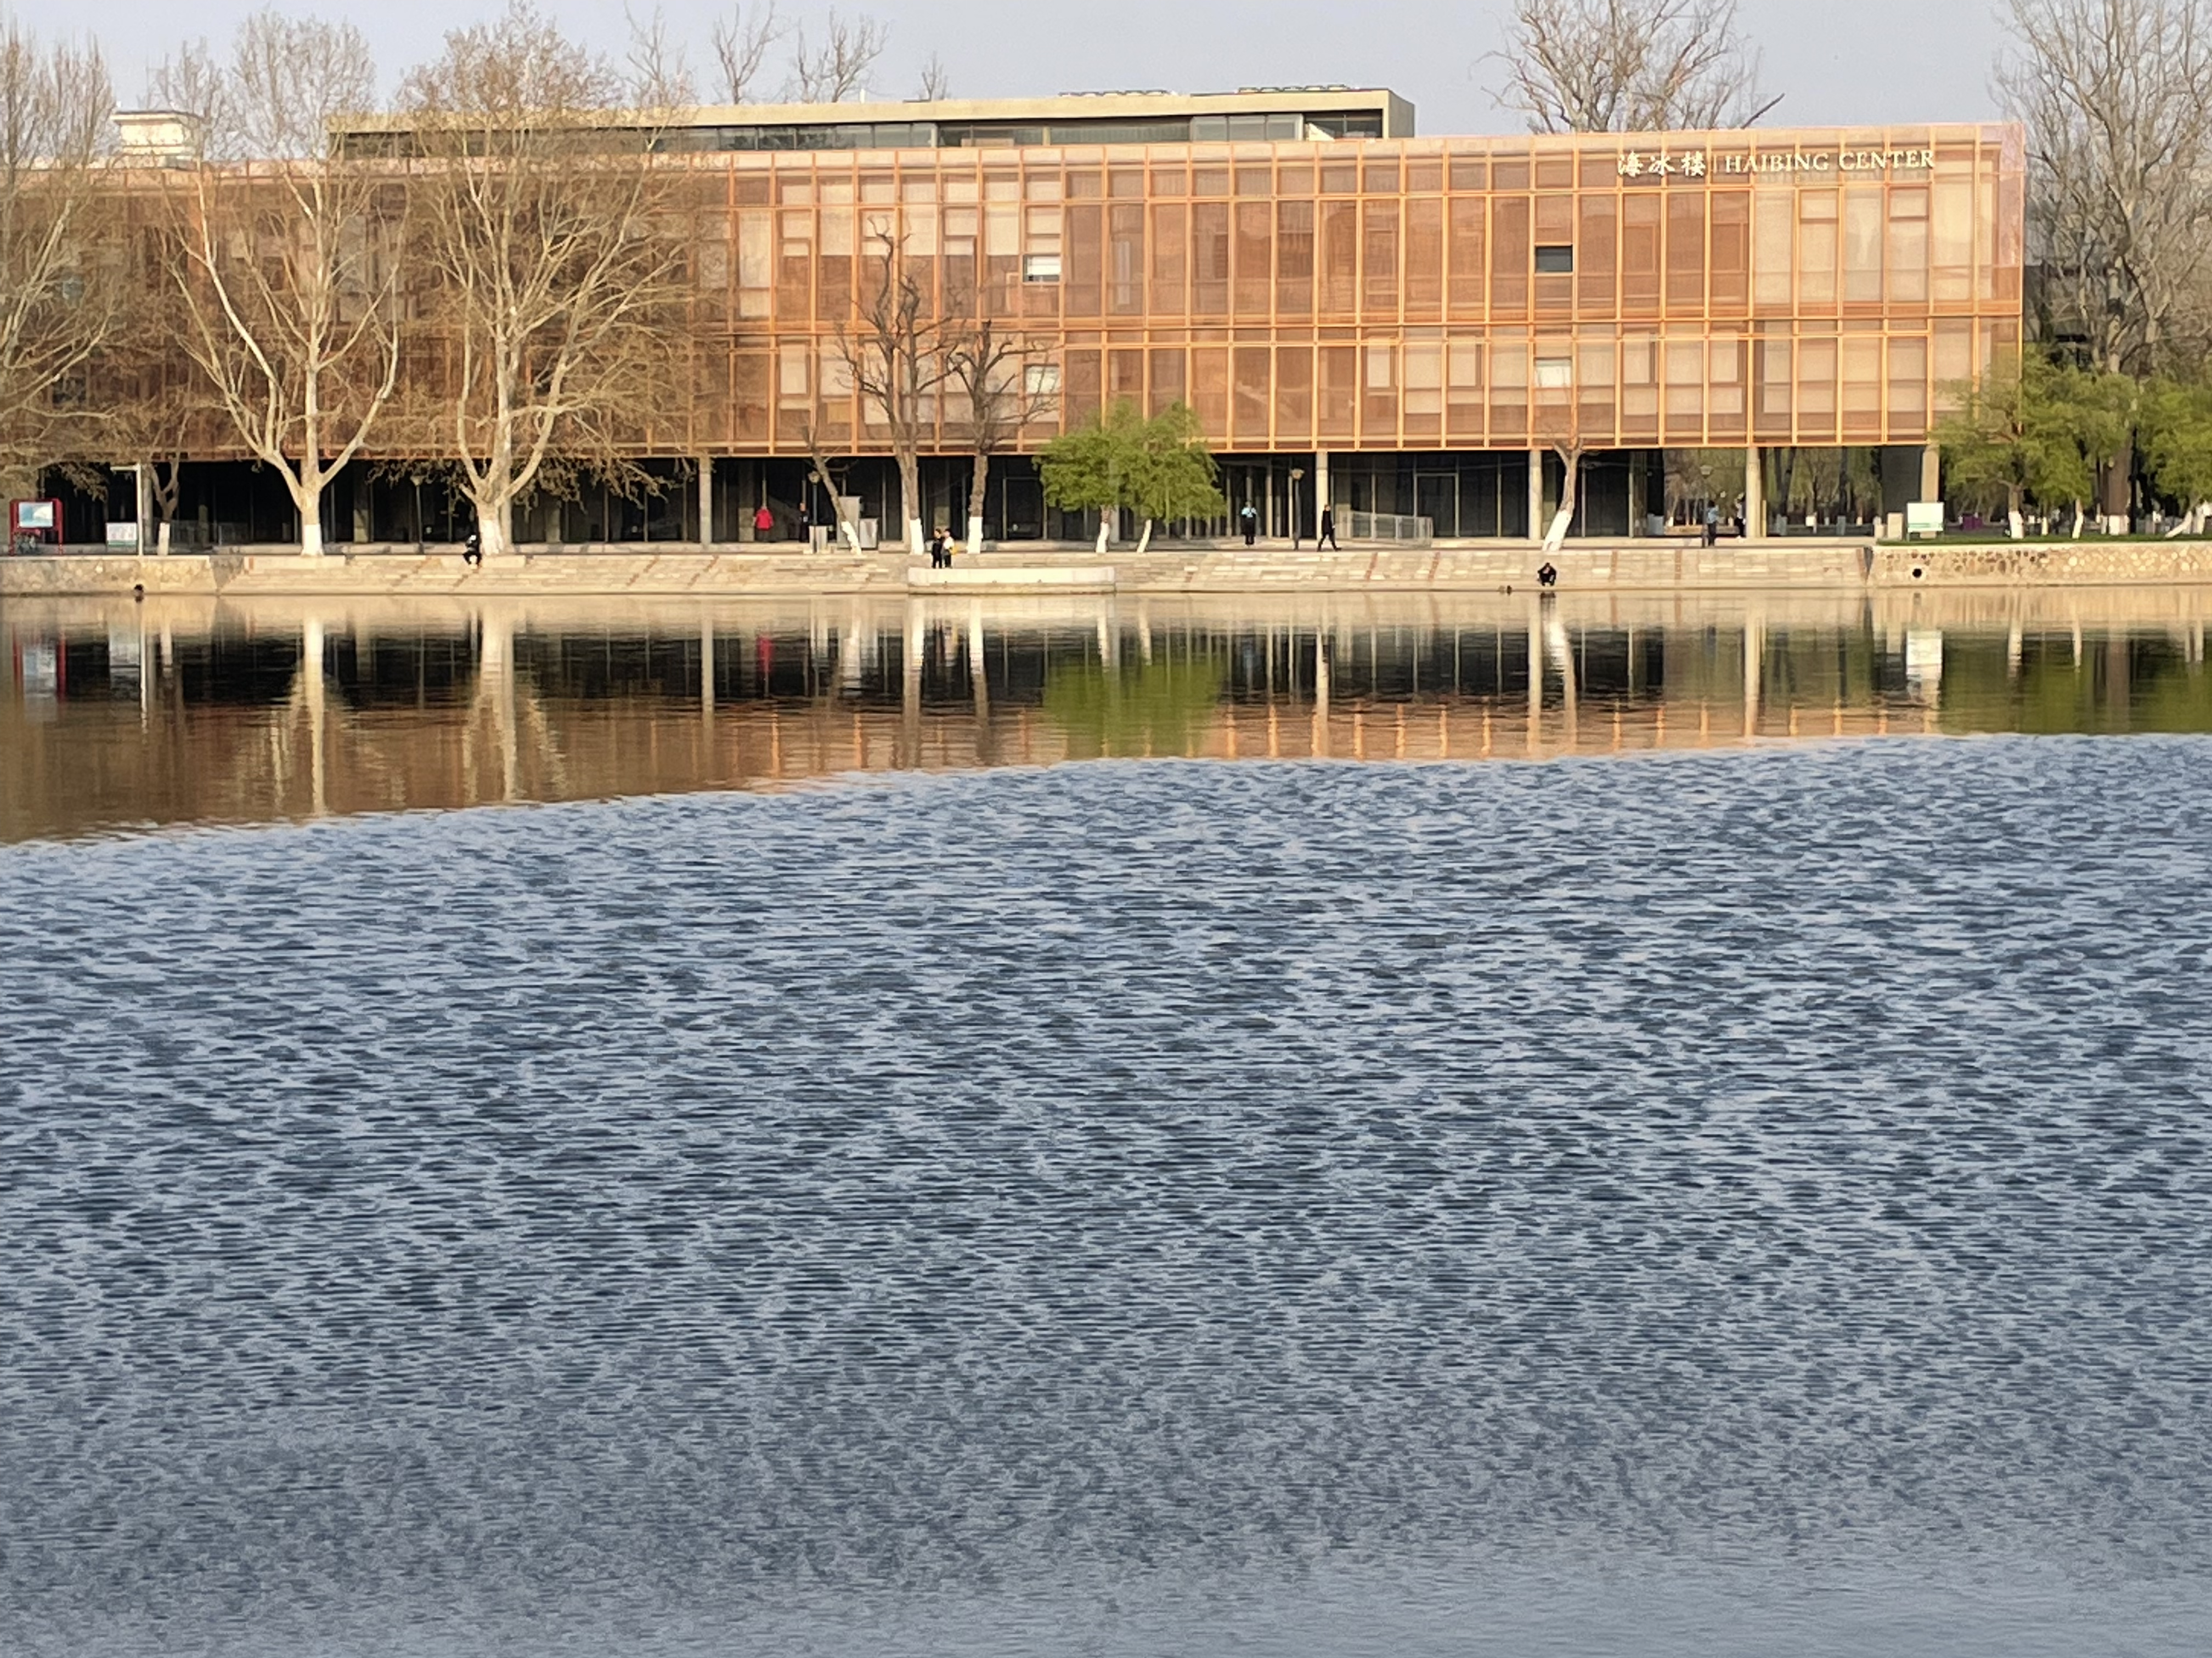
热物（第六七周尾巴）
Gibbs Sum
量子统计(绪论)
风乍起，吹皱半池春水

Slide 2
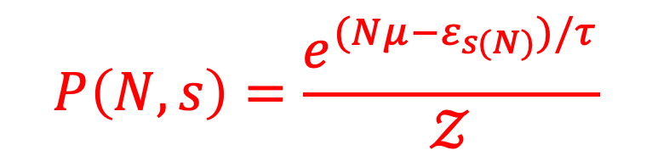
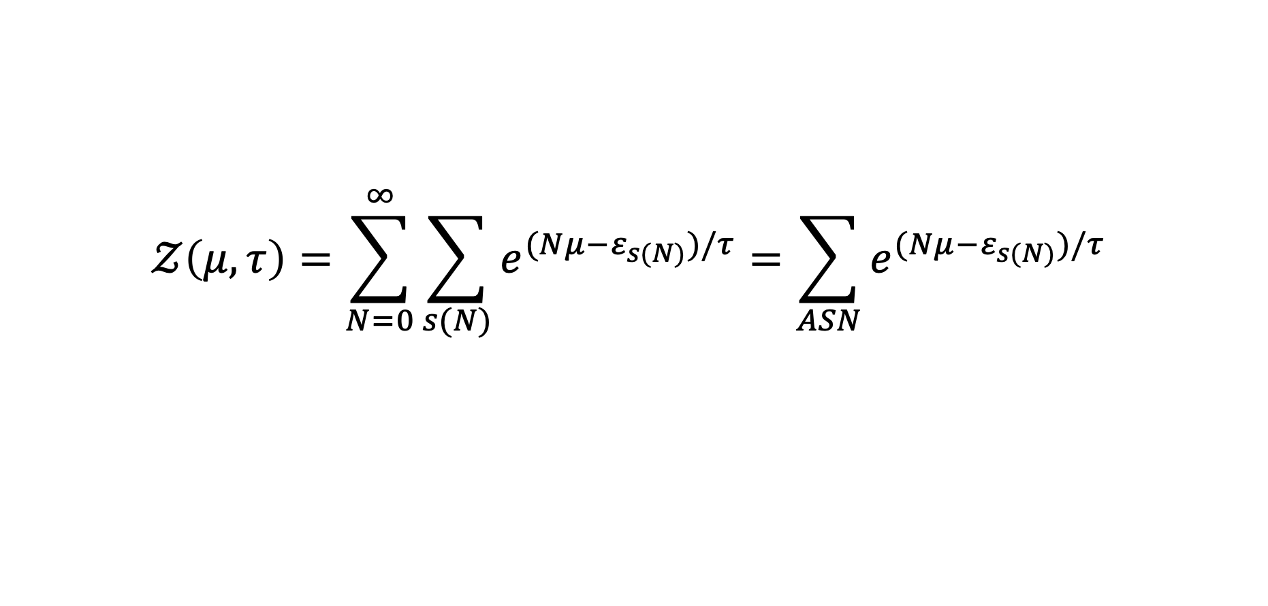

Gibbs Factor
$$e^{(Nμ−ε_{s(N)})/τ}$$
Gibbs Sum=Grand Partition Function
$$𝒵\left(μ,τ\right)=\sum_{N=0}^{∞}{\sum_{s(N)}{e^{(Nμ−ε_{s(N)})/τ}}=\sum_{ASN}{e^{(Nμ−ε_{s(N)})/τ}}}$$
Probability of having N particles, and being in the state “s”
$$P\left(N,s\right)=\frac{e^{(Nμ−ε_{s(N)})/τ}}{𝒵}$$

Slide 3
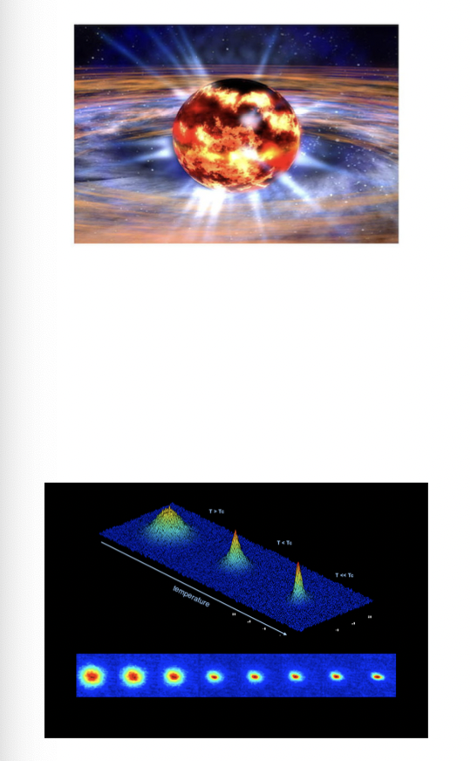

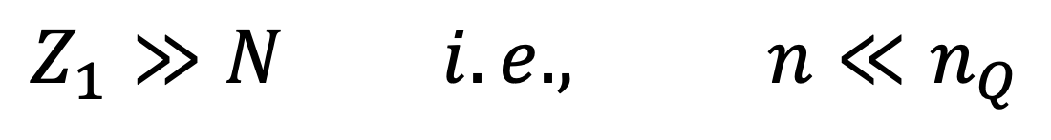
The number of available single-particle states
$$Z_{1}=n_{Q}V$$
$$Z_{1}≫N i.e., n≪n_{Q}$$
Which says that the average distance between particles must be greater than the average de Broglie wavelength!!!
If the gas is sufficiently dense, the wavefunction will start to touch and overlap. At this point it starts to matter whether the particles are fermions or bosons…the behavior will be much different from that of a normal gas.
Very dense, very cold, very light particle, etc.

Slide 4
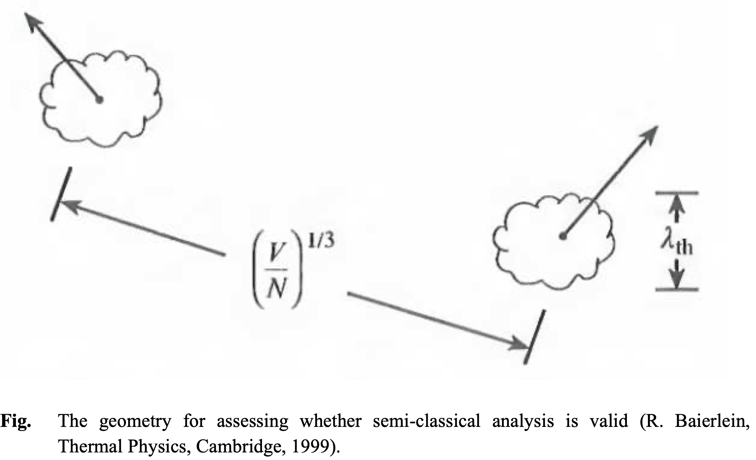
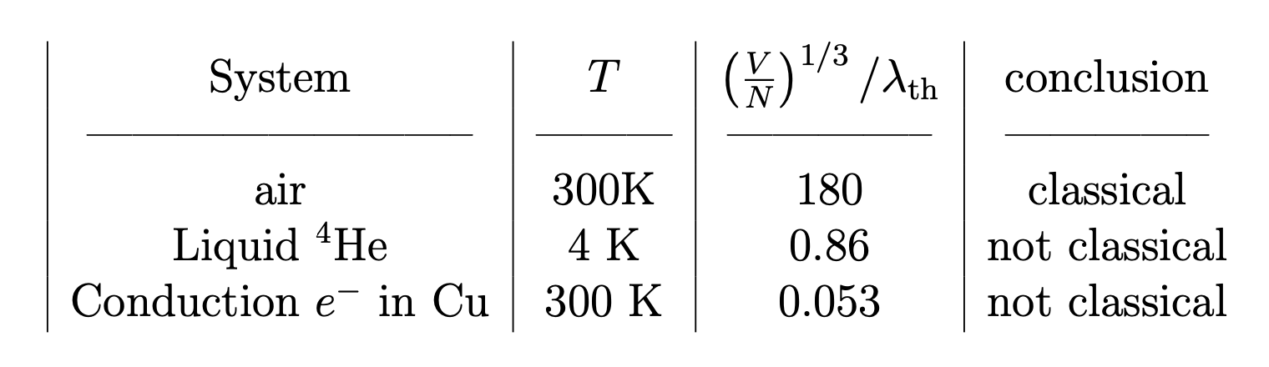

Slide 5
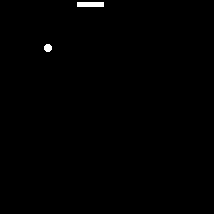
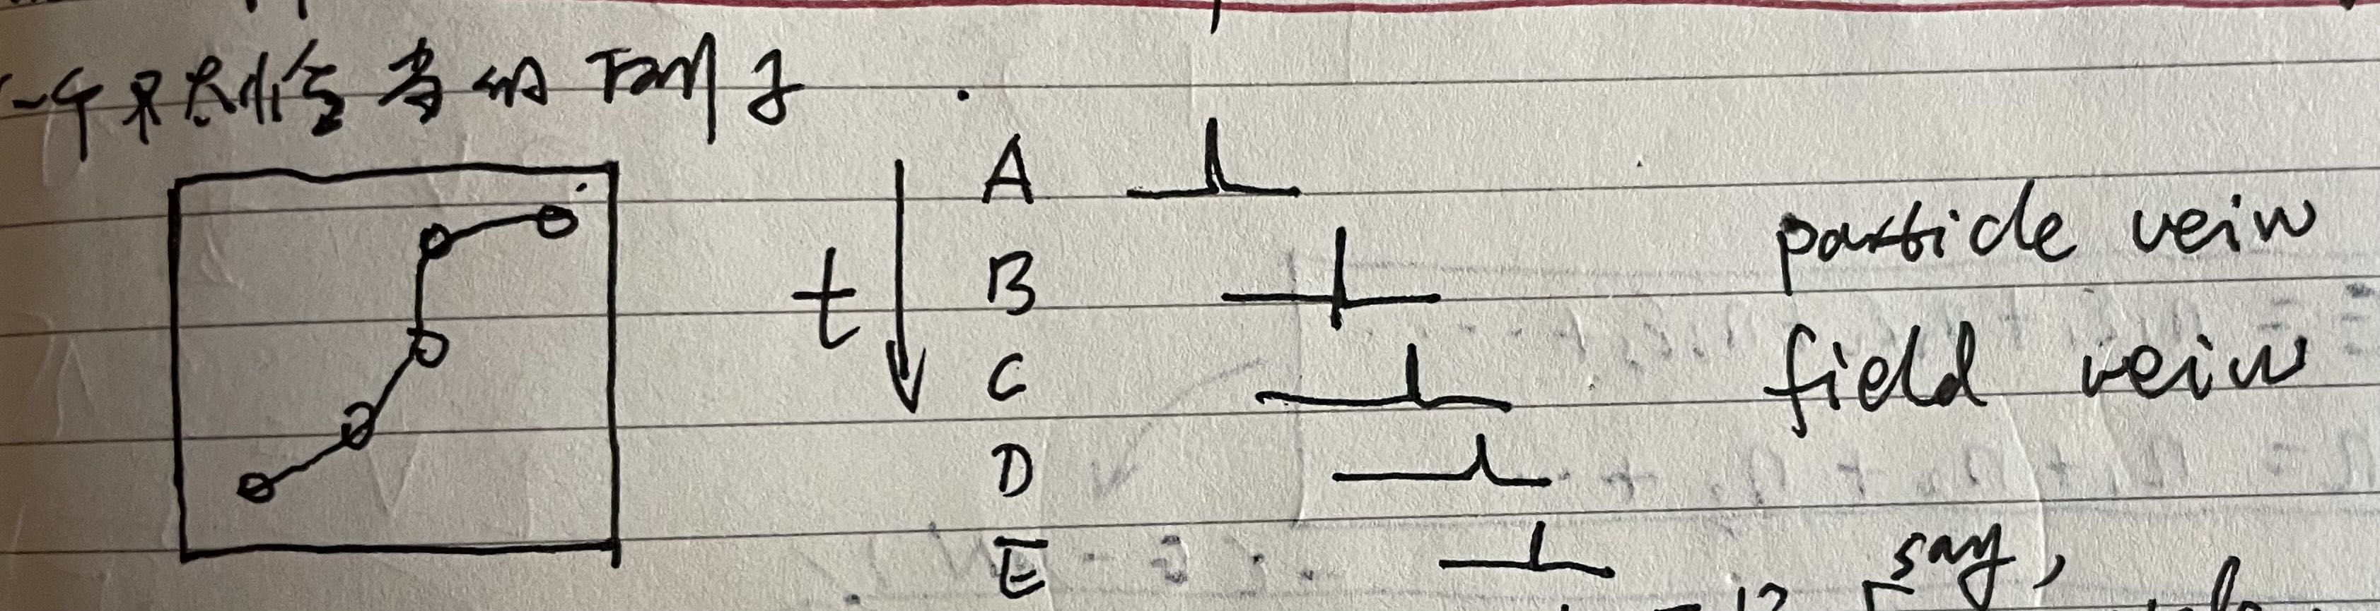
追踪
2*2格子

Slide 6
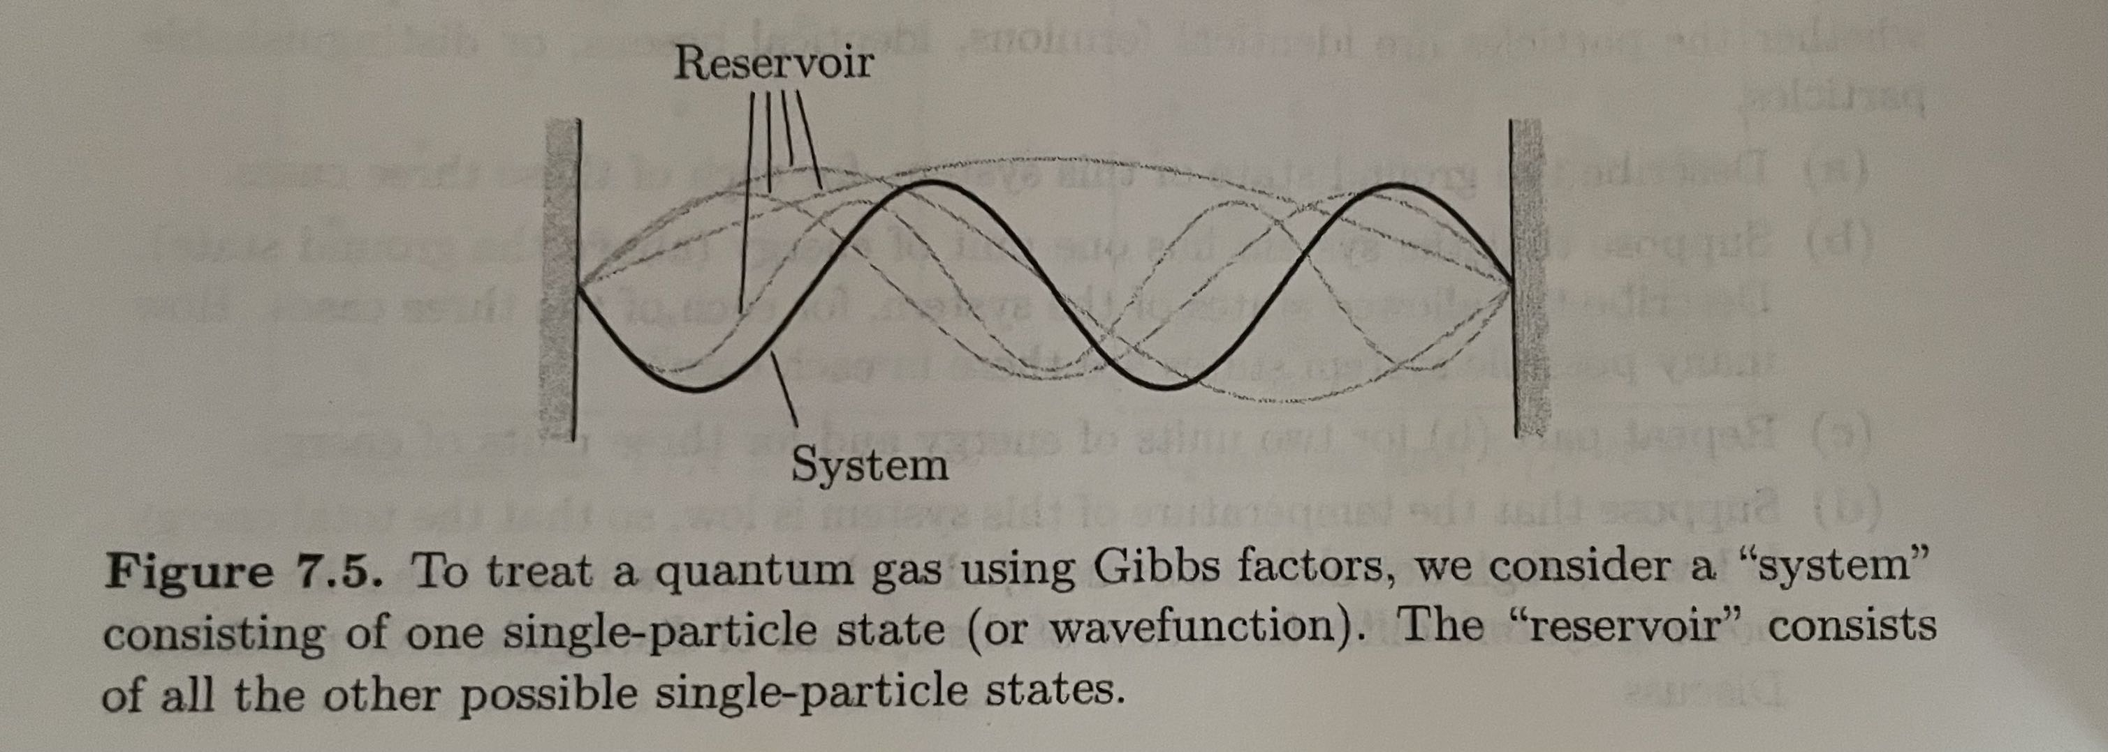
Let’s concentrate on just one single-particle state of a system(a particle in a box), whose energy when occupied by a single particle is $ε$.

Slide 7
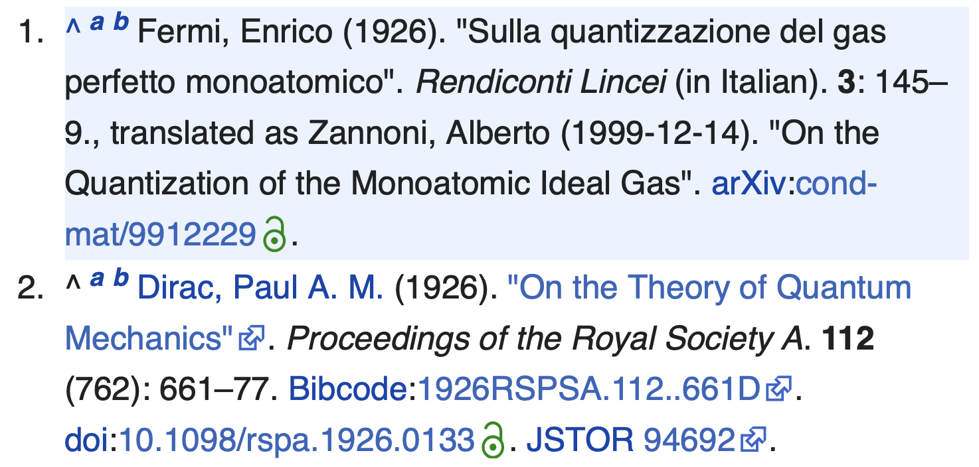
Fermi-Dirac Distribution function

Slide 8
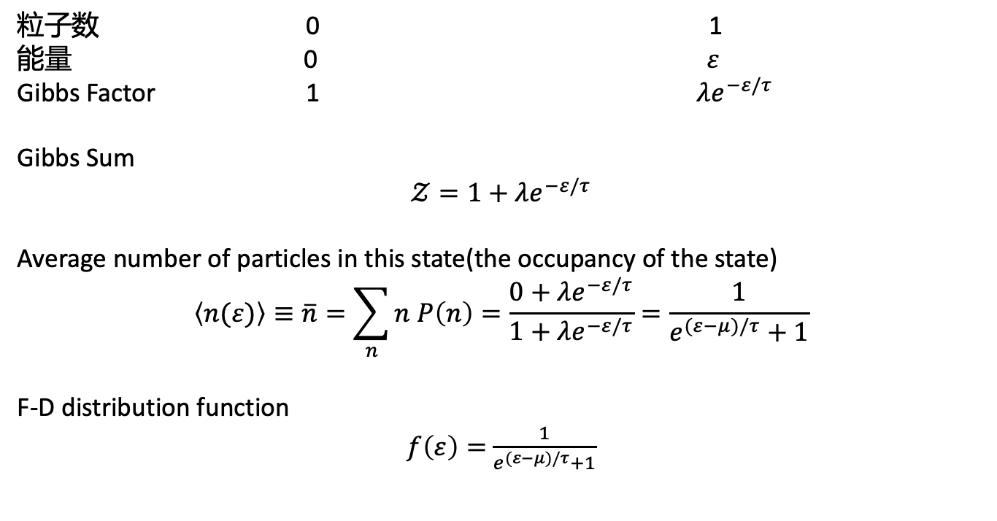
Grand Canonical Ensemble
1，一个轨道（态），能量标记为$ε$
粒子数 0 1
能量 0 $ε$
Gibbs Factor 1 $λe^{−ε/τ}$
Gibbs Sum
$𝒵=1+λe^{−ε/τ}$
Average number of particles in this state(the occupancy of the state)
$$\left\langle n(ε)\right\rangle ≡\overline{n}=\sum_{n}{n P\left(n\right)=\frac{0+λe^{−ε/τ}}{1+λe^{−ε/τ}}=\frac{1}{e^{(ε−μ)/τ}+1}}$$
F-D distribution function
$f\left(ε\right)=$ $\frac{1}{e^{(ε−μ)/τ}+1}$

Slide 9

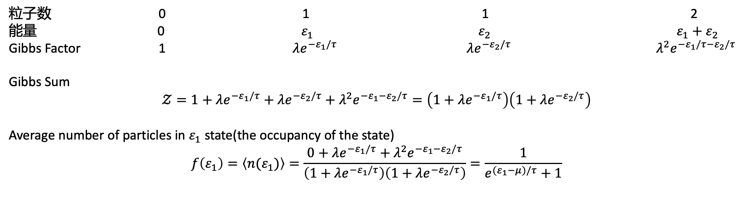

2，两个轨道（态s），能量标记为$ε_{1},ε_{2}$
$$ε_{2}$$
$$ε_{1}$$
粒子数 0 1 1 2
能量 0 $ε_{1}$ ${ ε}_{2}$ $ε_{1}+ε_{2}$
Gibbs Factor 1 $λe^{−ε_{1}/τ} λe^{−ε_{2}/τ} λ^{2}e^{−ε_{1}/τ−ε_{2}/τ}$
Gibbs Sum
$$𝒵=1+λe^{−ε_{1}/τ}+λe^{−ε_{2}/τ}+λ^{2}e^{−ε_{1}−ε_{2}/τ}=\left(1+λe^{−ε_{1}/τ}\right)\left(1+λe^{−ε_{2}/τ}\right)$$
Average number of particles in $ε_{1}$ state(the occupancy of the state)
$$f\left(ε_{1}\right)=\left\langle n(ε_{1})\right\rangle =\frac{0+λe^{−ε_{1}/τ}+λ^{2}e^{−ε_{1}−ε_{2}/τ}}{\left(1+λe^{−ε_{1}/τ}\right)\left(1+λe^{−ε_{2}/τ}\right)}=\frac{1}{e^{(ε_{1}−μ)/τ}+1}$$

Slide 10
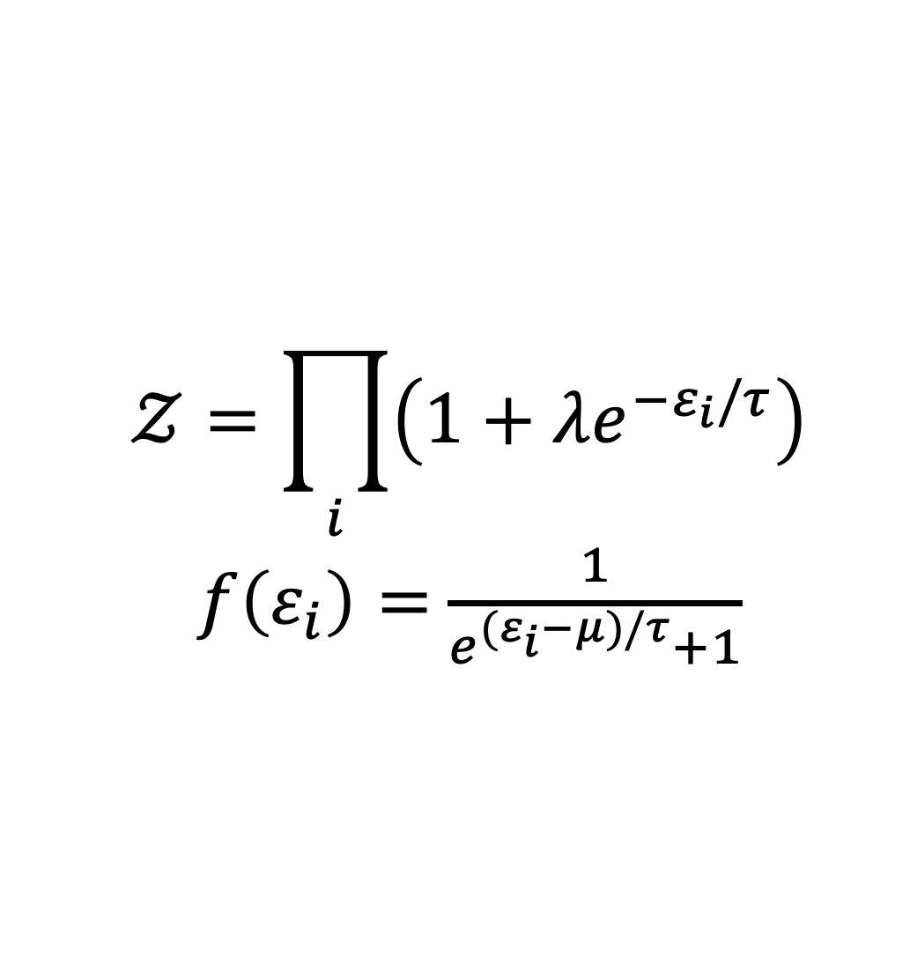
3，任意个轨道（态s），能量标记为$ε_{i}$
$$𝒵=\prod_{i}{\left(1+λe^{−ε_{i}/τ}\right)}$$
$f\left(ε_{i}\right)=$ $\frac{1}{e^{(ε_{i}−μ)/τ}+1}$

Slide 11
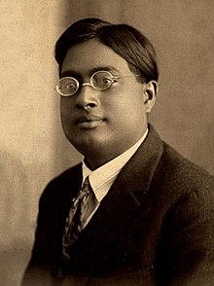
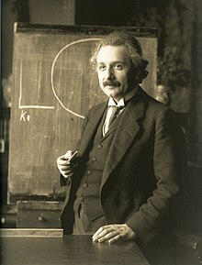
Bose-Einstein Distribution function

Slide 12
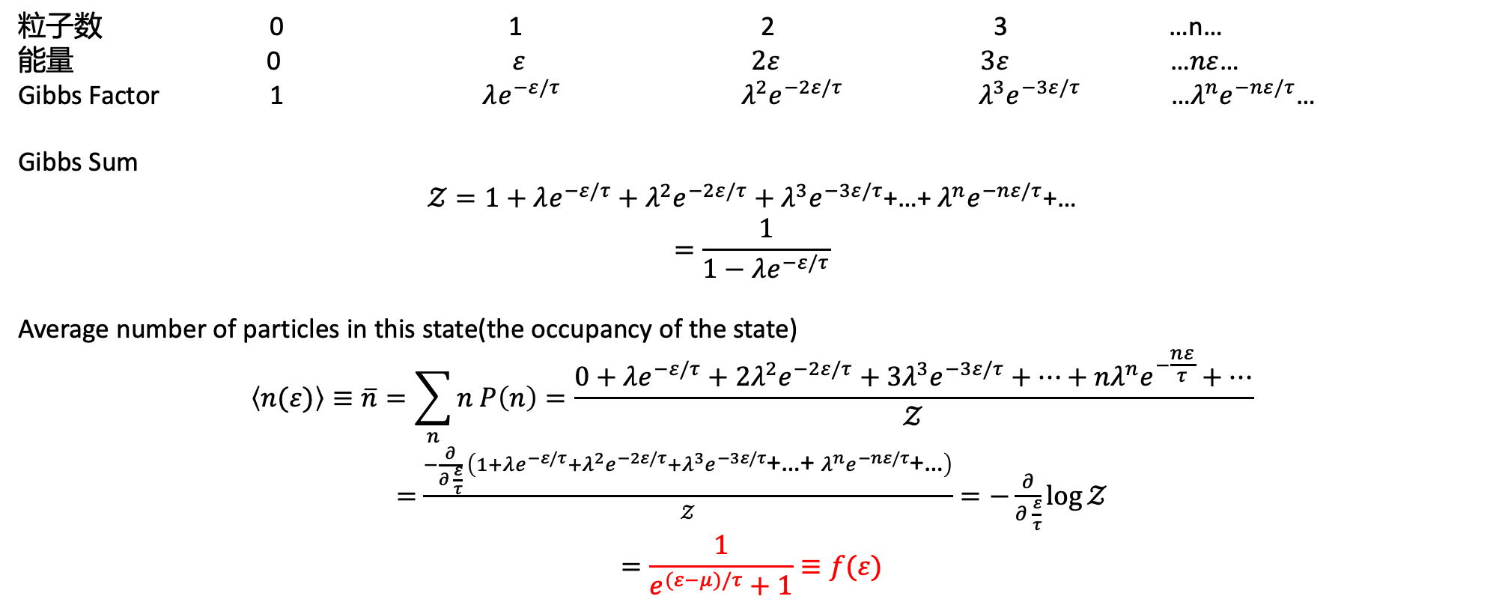
Grand Canonical Ensemble
1，一个轨道（态），能量标记为$ε$
……
粒子数 0 1 2 3 …n…
能量 0 $ε$ $2ε$ $3ε$ …$nε$…
Gibbs Factor 1 $λe^{−ε/τ}$ $λ^{2}e^{−2ε/τ}$ $λ^{3}e^{−3ε/τ}$ …$λ^{n}e^{−nε/τ}$…
Gibbs Sum
$𝒵=1+λe^{−ε/τ}+λ^{2}e^{−2ε/τ}+λ^{3}e^{−3ε/τ}$+…+ $λ^{n}e^{−nε/τ}$+…
$$=\frac{1}{1−λe^{−ε/τ}}$$
Average number of particles in this state(the occupancy of the state)
$$\left\langle n(ε)\right\rangle ≡\overline{n}=\sum_{n}{n P\left(n\right)=\frac{0+λe^{−ε/τ}+2λ^{2}e^{−2ε/τ}+3λ^{3}e^{−3ε/τ}+…+nλ^{n}e^{−\frac{nε}{τ}}+…}{𝒵}}$$
$=$ $\frac{−\frac{∂}{∂ \frac{ε}{τ}} \left(1+λe^{−ε/τ}+λ^{2}e^{−2ε/τ}+λ^{3}e^{−3ε/τ}\text{+…+ }λ^{n}e^{−nε/τ}\text{+…}\right)}{𝒵}=−\frac{∂}{∂ \frac{ε}{τ}}\log{𝒵}$
$$=\frac{1}{e^{(ε−μ)/τ}+1}≡f(ε)$$

Slide 13
2，两个轨道（态s），能量标记为$ε_{1},ε_{2}$
$$ε_{2}$$
……
$$ε_{1}$$
Gibbs Sum
$$𝒵=1+λe^{−ε_{1}/τ}+λe^{−ε_{2}/τ}+λ^{2}e^{−{2ε}_{1}/τ}+λ^{2}e^{−ε_{1}−ε_{2}/τ}+λ^{2}e^{−2ε_{2}/τ}+…$$
$$=\left(1+λe^{−ε1/τ}+λ^{2}e^{−2ε1/τ}+…\right)\left(1+λe^{−ε2/τ}+λ^{2}e^{−2ε2/τ}+…\right)$$

Slide 14
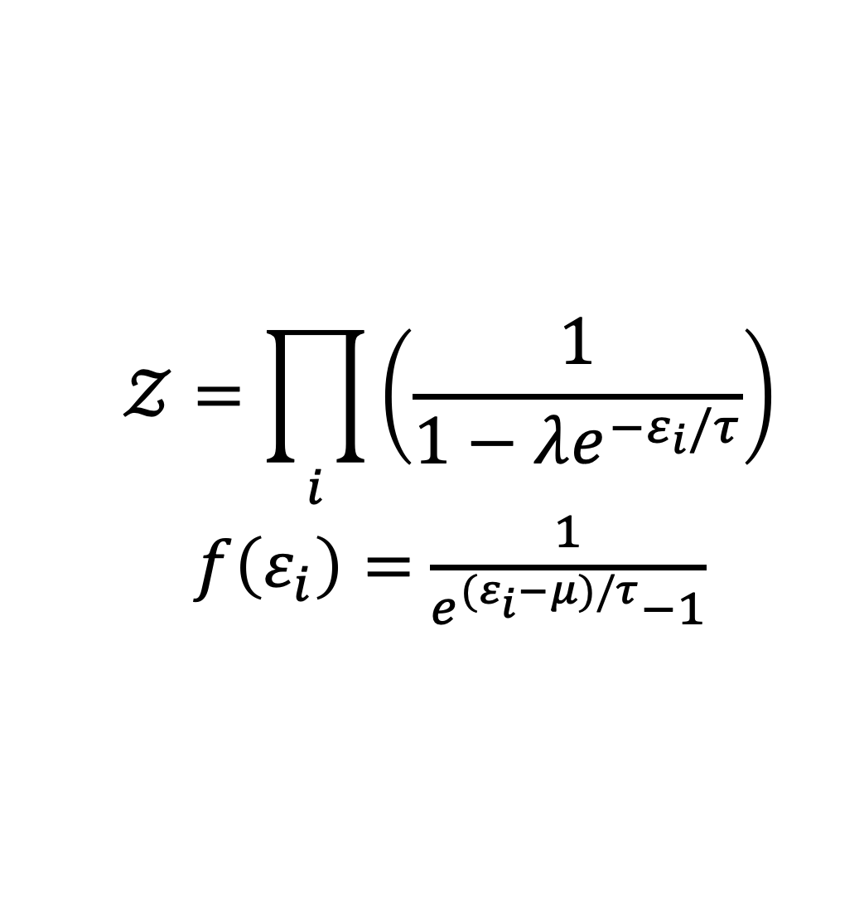
3，任意个轨道（态s），能量标记为$ε_{i}$
$$𝒵=\prod_{i}{\left(\frac{1}{1−λe^{−ε_{i}/τ}}\right)}$$
$f\left(ε_{i}\right)=$ $\frac{1}{e^{(ε_{i}−μ)/τ}−1}$

Slide 15
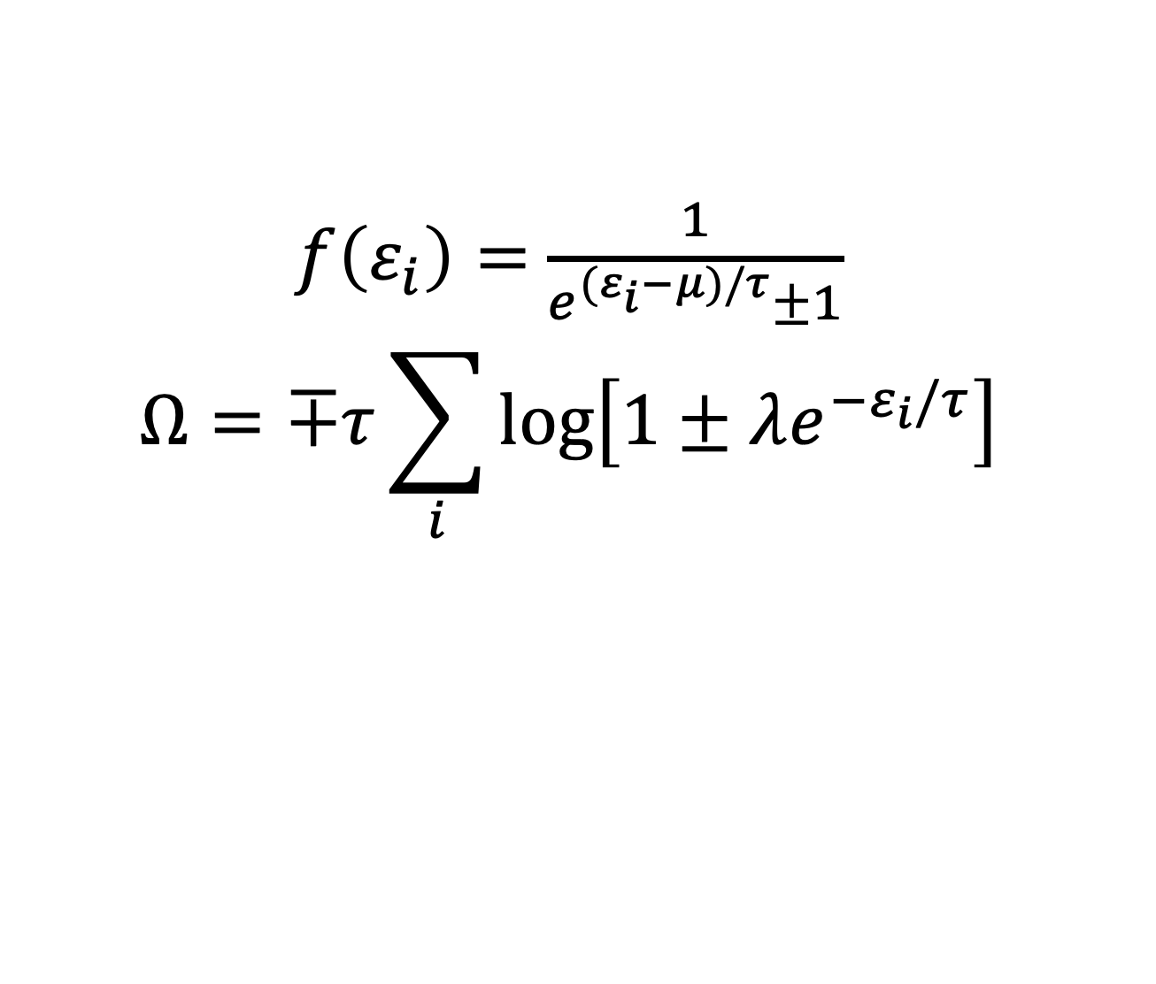
总结一下
$f\left(ε_{i}\right)=$ $\frac{1}{e^{(ε_{i}−μ)/τ}±1}$
$$Ω=∓τ\sum_{i}{\log\left[1±λe^{−ε_{i}/τ}\right]}$$
“+” for fermion
“-” for boson
风暴一下（板书）

Slide 16
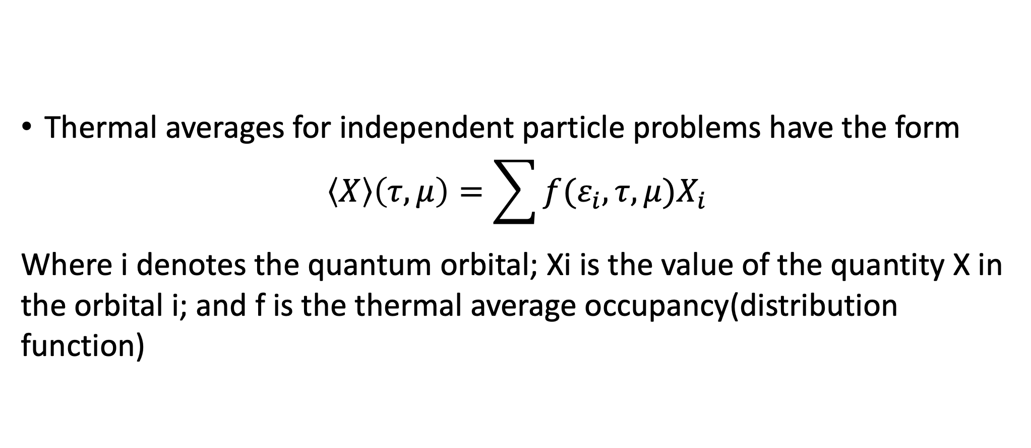
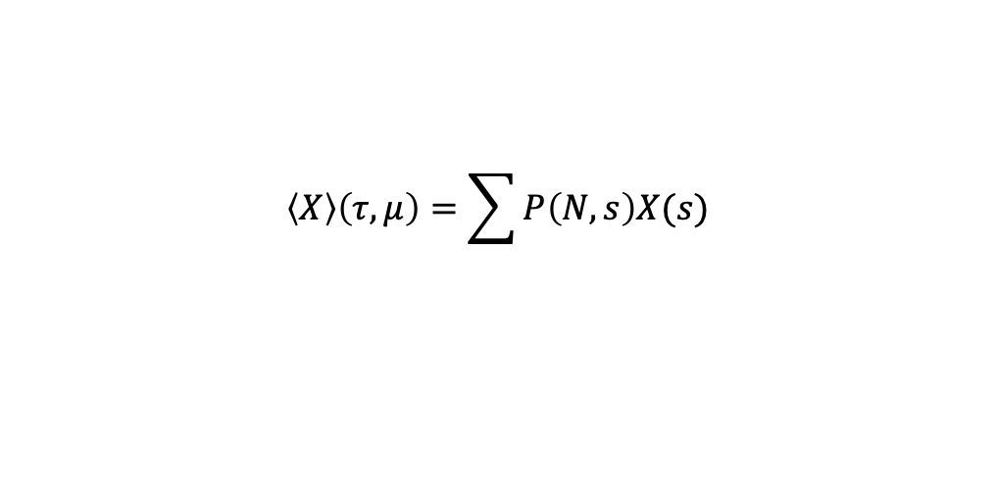
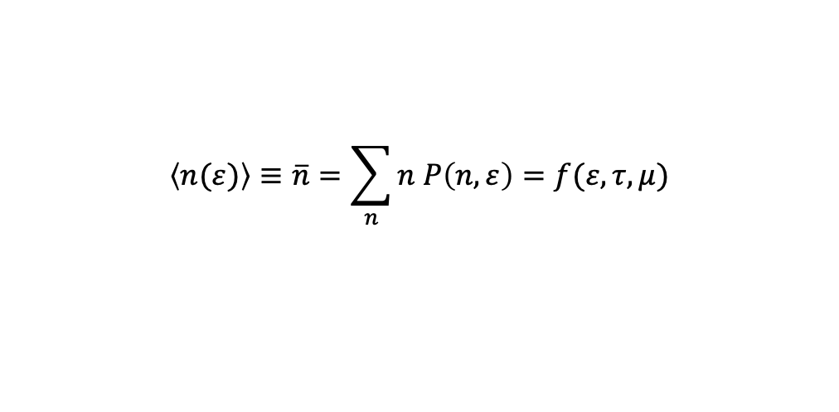
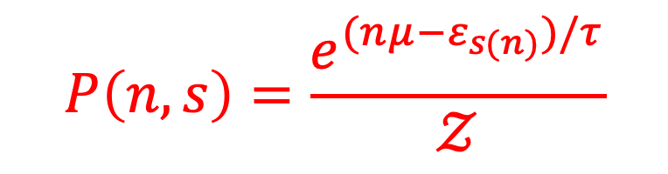
$$P\left(n,s\right)=\frac{e^{(nμ−ε_{s(n)})/τ}}{𝒵}$$
$$\left\langle n(ε)\right\rangle ≡\overline{n}=\sum_{n}{n P\left(n,ε\right)=f(ε,τ,μ)}$$
$$\left\langle X\right\rangle \left(τ,μ\right)=\sum{P\left(N,s\right)X(s)}$$
Thermal averages for independent particle problems have the form
$$\left\langle X\right\rangle \left(τ,μ\right)=\sum{f(ε_{i},τ,μ)X_{i}}$$
Where i denotes the quantum orbital; Xi is the value of the quantity X in the orbital i; and f is the thermal average occupancy(distribution function)

Slide 17
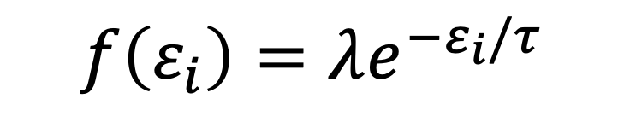
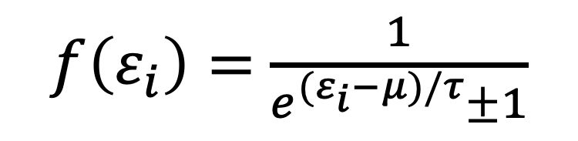
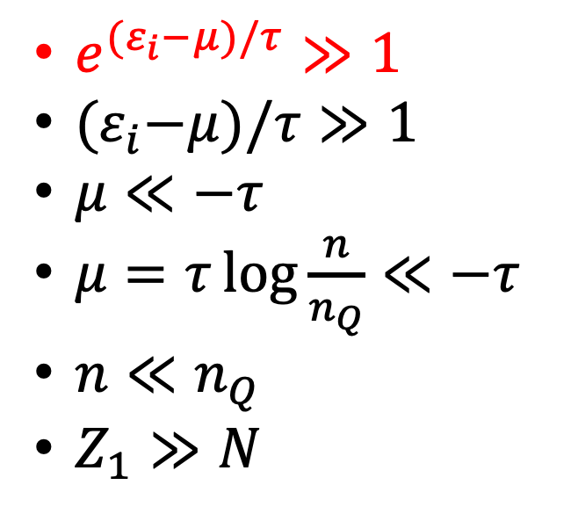

经典极限
$f\left(ε_{i}\right)=$ $\frac{1}{e^{(ε_{i}−μ)/τ}±1}$
$$e^{{(ε}_{i}−μ)/τ}≫1$$
$$f\left(ε_{i}\right)=λe^{−ε_{i}/τ}$$
$e^{{(ε}_{i}−μ)/τ}≫1$
${(ε}_{i}−μ)/τ≫1$
$μ≪−τ$
$μ=τ\log{\frac{n}{n_{Q}}≪−τ}$
$n≪n_{Q}$
$Z_{1}≫N$

Slide 18
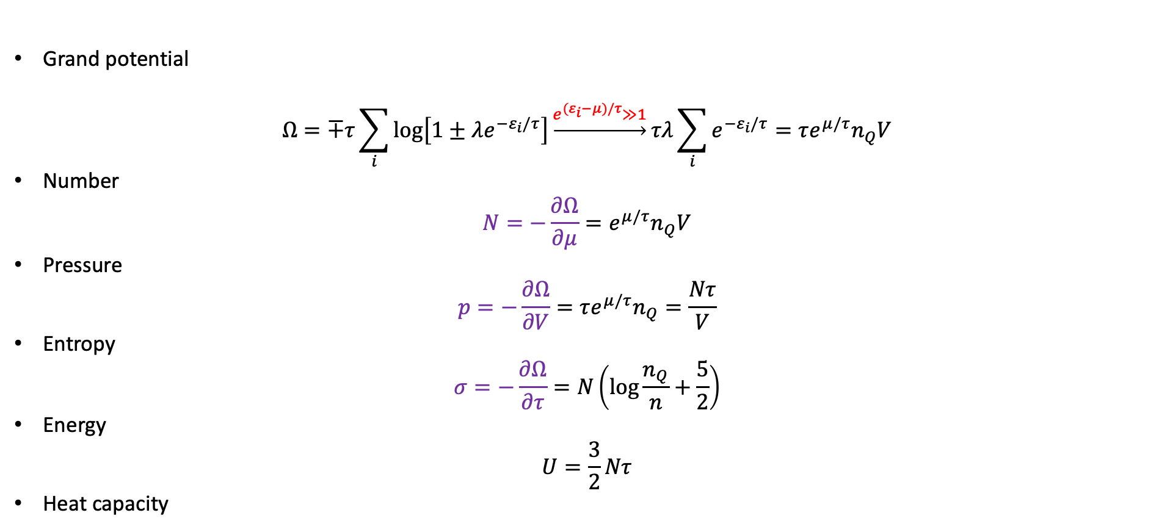
思路一：
Grand potential
$$Ω=∓τ\sum_{i}{\log\left[1±λe^{−ε_{i}/τ}\right]}\underset{→}{e^{{(ε}_{i}−μ)/τ}≫1}τλ\sum_{i}{e^{−ε_{i}/τ}=τe^{μ/τ}n_{Q}V}$$
Number
$$N=−\frac{∂Ω}{∂μ}=e^{μ/τ}n_{Q}V$$
Pressure
$$p=−\frac{∂Ω}{∂V}=τe^{μ/τ}n_{Q}=\frac{Nτ}{V}$$
Entropy
$$σ=−\frac{∂Ω}{∂τ}=N\left(\log{\frac{n_{Q}}{n}}+\frac{5}{2}\right)$$
Energy
$$U=\frac{3}{2}Nτ$$
Heat capacity

Slide 19
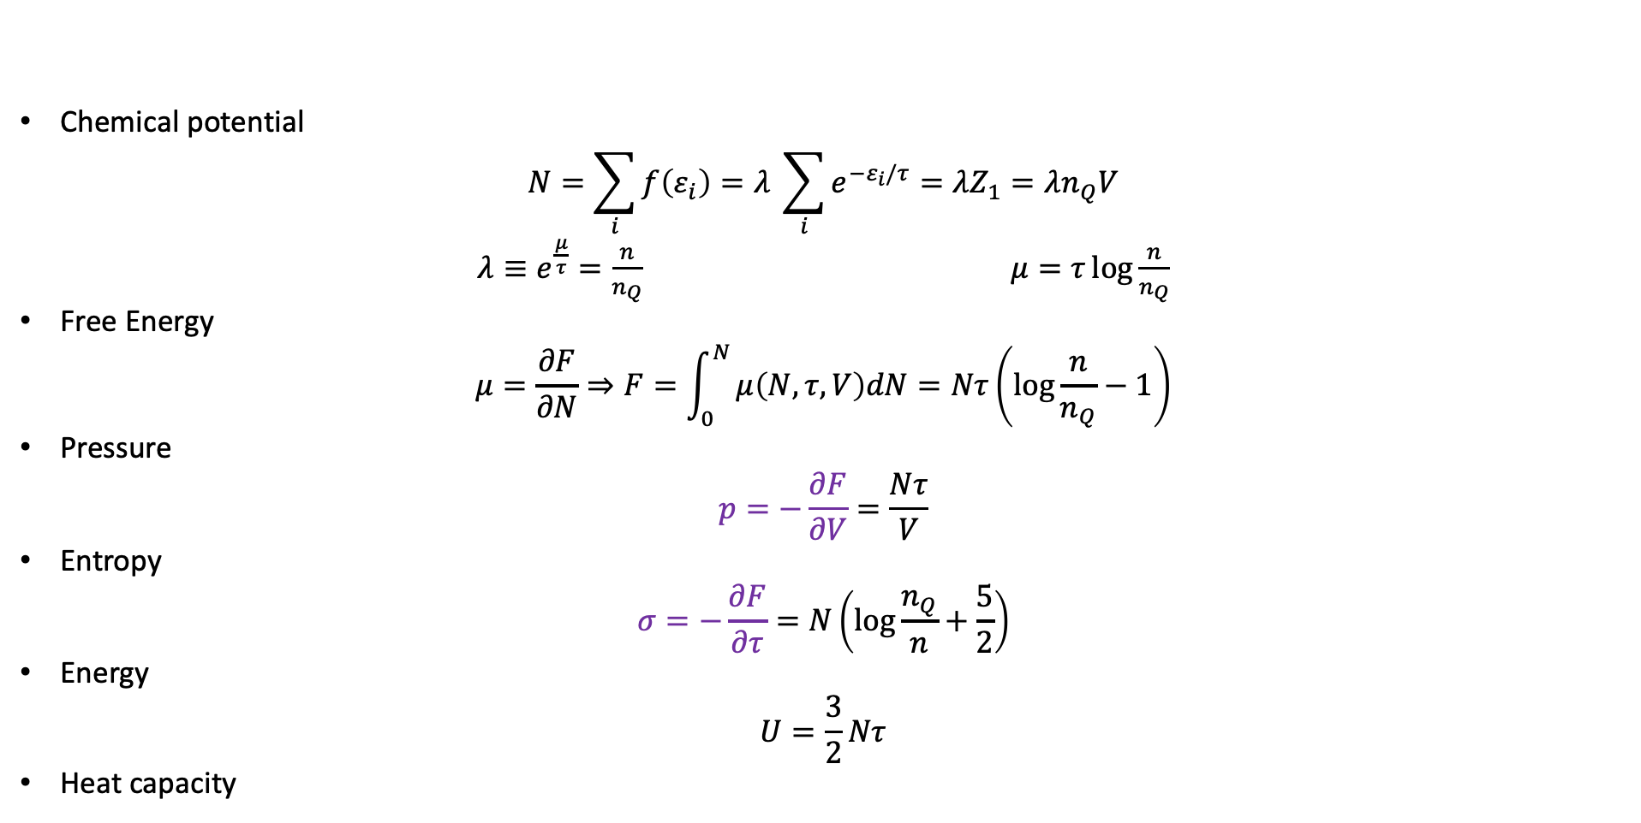
思路二：
Chemical potential
$$N=\sum_{i}{f\left(ε_{i}\right)=λ \sum_{i}{e^{−ε_{i}/τ}}=λZ_{1}=λn_{Q}V}$$
$λ≡e^{\frac{μ}{τ}}=\frac{n}{n_{Q}}$ $μ=τ\log{\frac{n}{n_{Q}}}$
Free Energy
$$μ=\frac{∂F}{∂N}⇒F=\int_{0}^{N}{μ\left(N,τ,V\right)dN=Nτ\left(\log{\frac{n}{n_{Q}}−1}\right)}$$
Pressure
$$p=−\frac{∂F}{∂V}=\frac{Nτ}{V}$$
Entropy
$$σ=−\frac{∂F}{∂τ}=N\left(\log{\frac{n_{Q}}{n}}+\frac{5}{2}\right)$$
Energy
$$U=\frac{3}{2}Nτ$$
Heat capacity

Slide 20
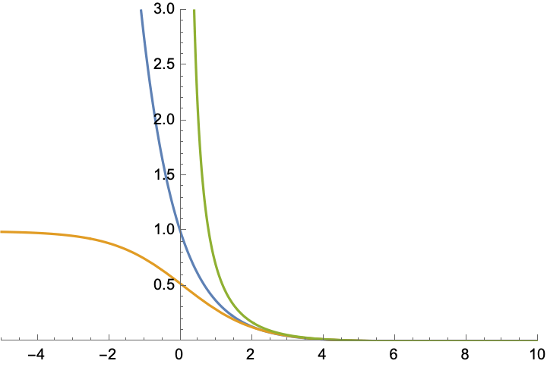
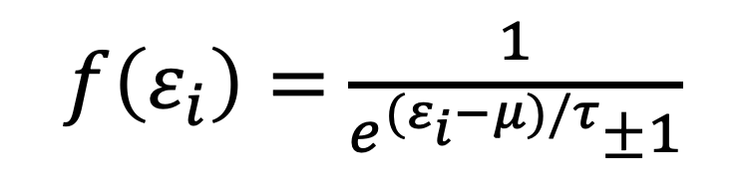

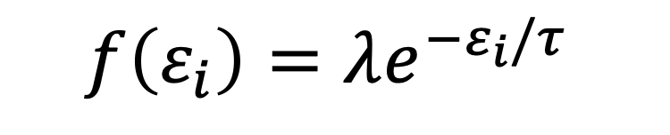
$$f\left(ε_{i}\right)=λe^{−ε_{i}/τ}$$
$f\left(ε_{i}\right)=$ $\frac{1}{e^{(ε_{i}−μ)/τ}±1}$
$$\frac{ε_{i}−μ}{τ}$$

Slide 21
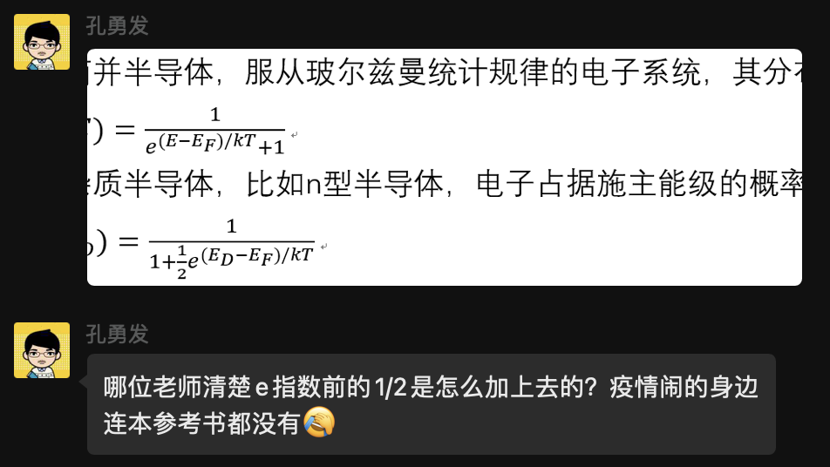
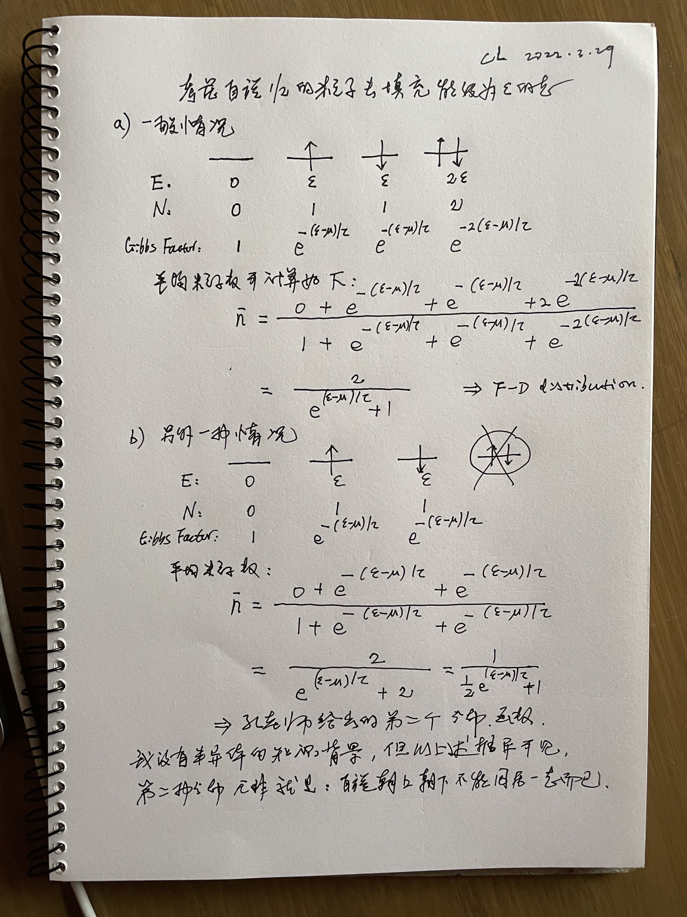

Slide 22
从固体热熔讲起

Slide 23
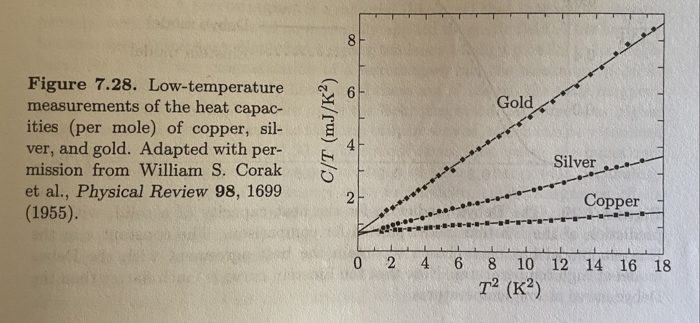
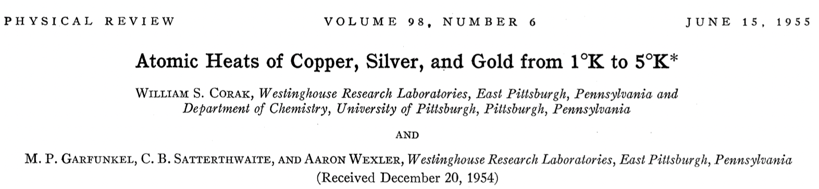

Slide 24
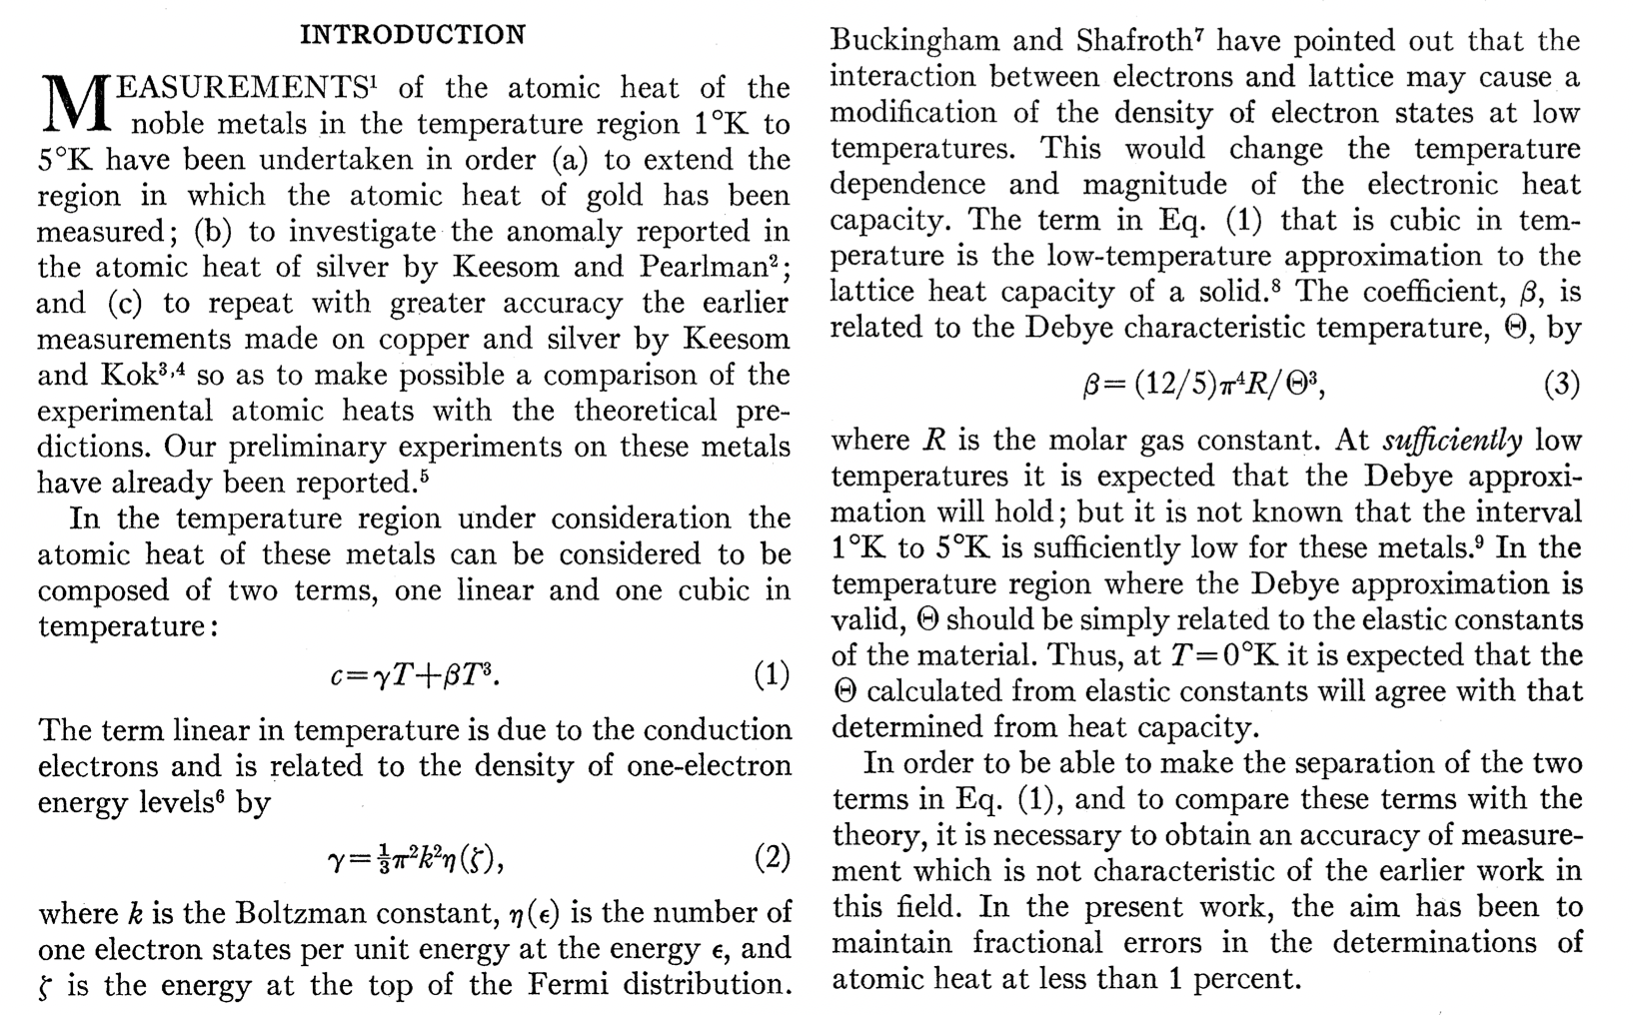

Slide 25
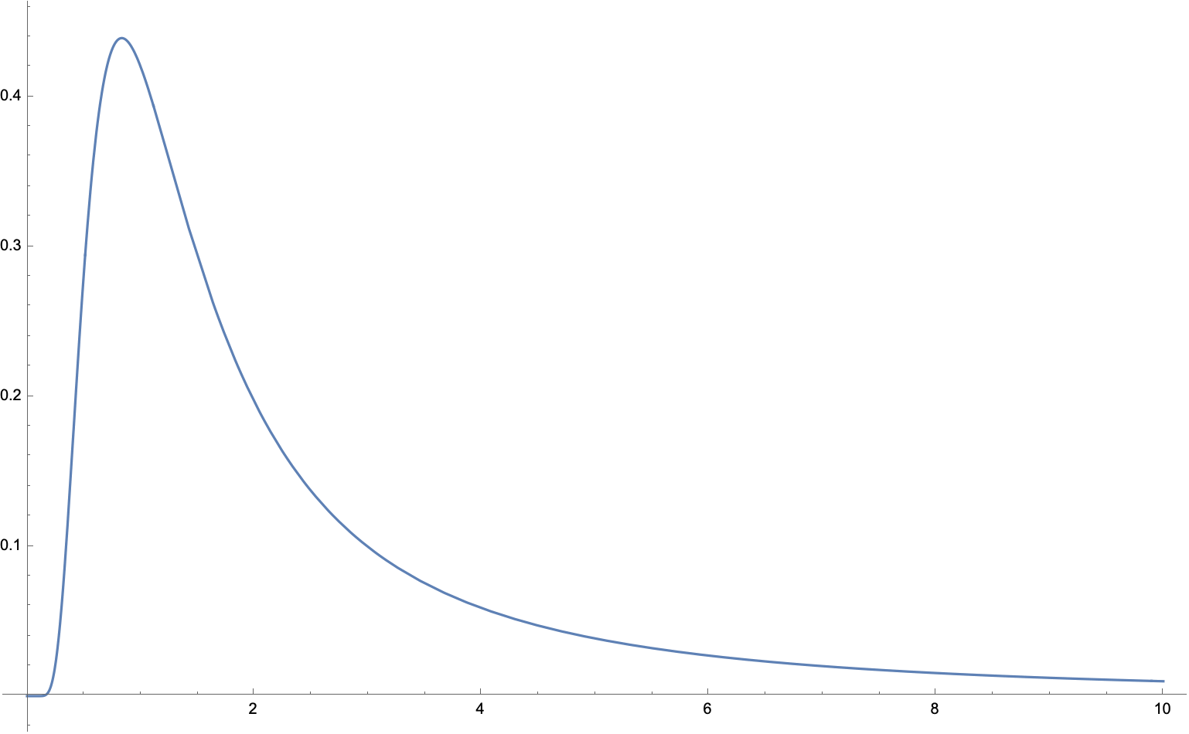

$$C=γτ+βτ^{3}$$
Part-2, 爱因斯坦solid 查笔记
The heat capacity goes to zero exponentially in the limit tau->0.

